Slide 1
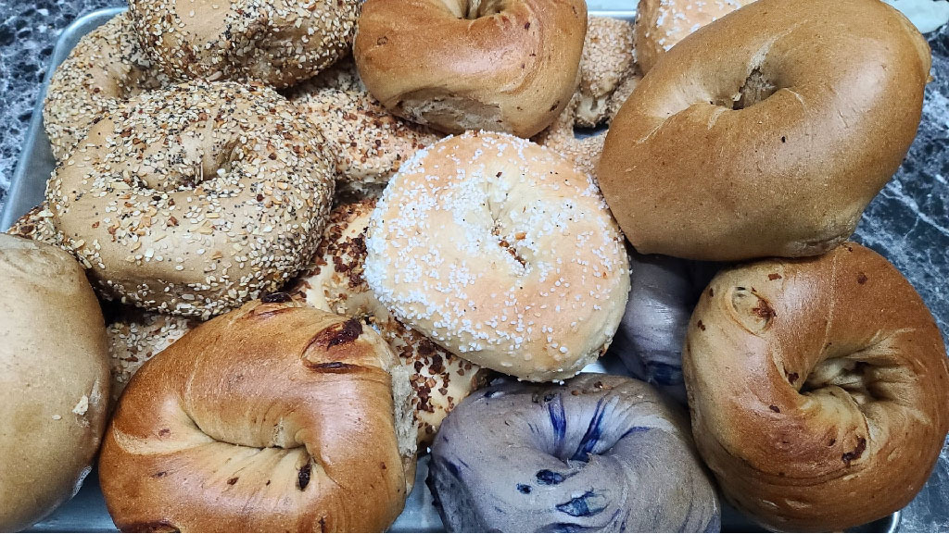
Inwood Bagels
Team 2
Gaelle Giles - Project Manager
Charles Adams - Product Owner
Noah Ponticiello - DBA
Masha Obaturova - Lead Developer
Hemawsi Gorrela - Developer
Nandu Devarasetty - Lead Business Analyst
Abhilash Gubbala - Lead QA Analyst
Brindavani Pathuri - Tester

Slide 2
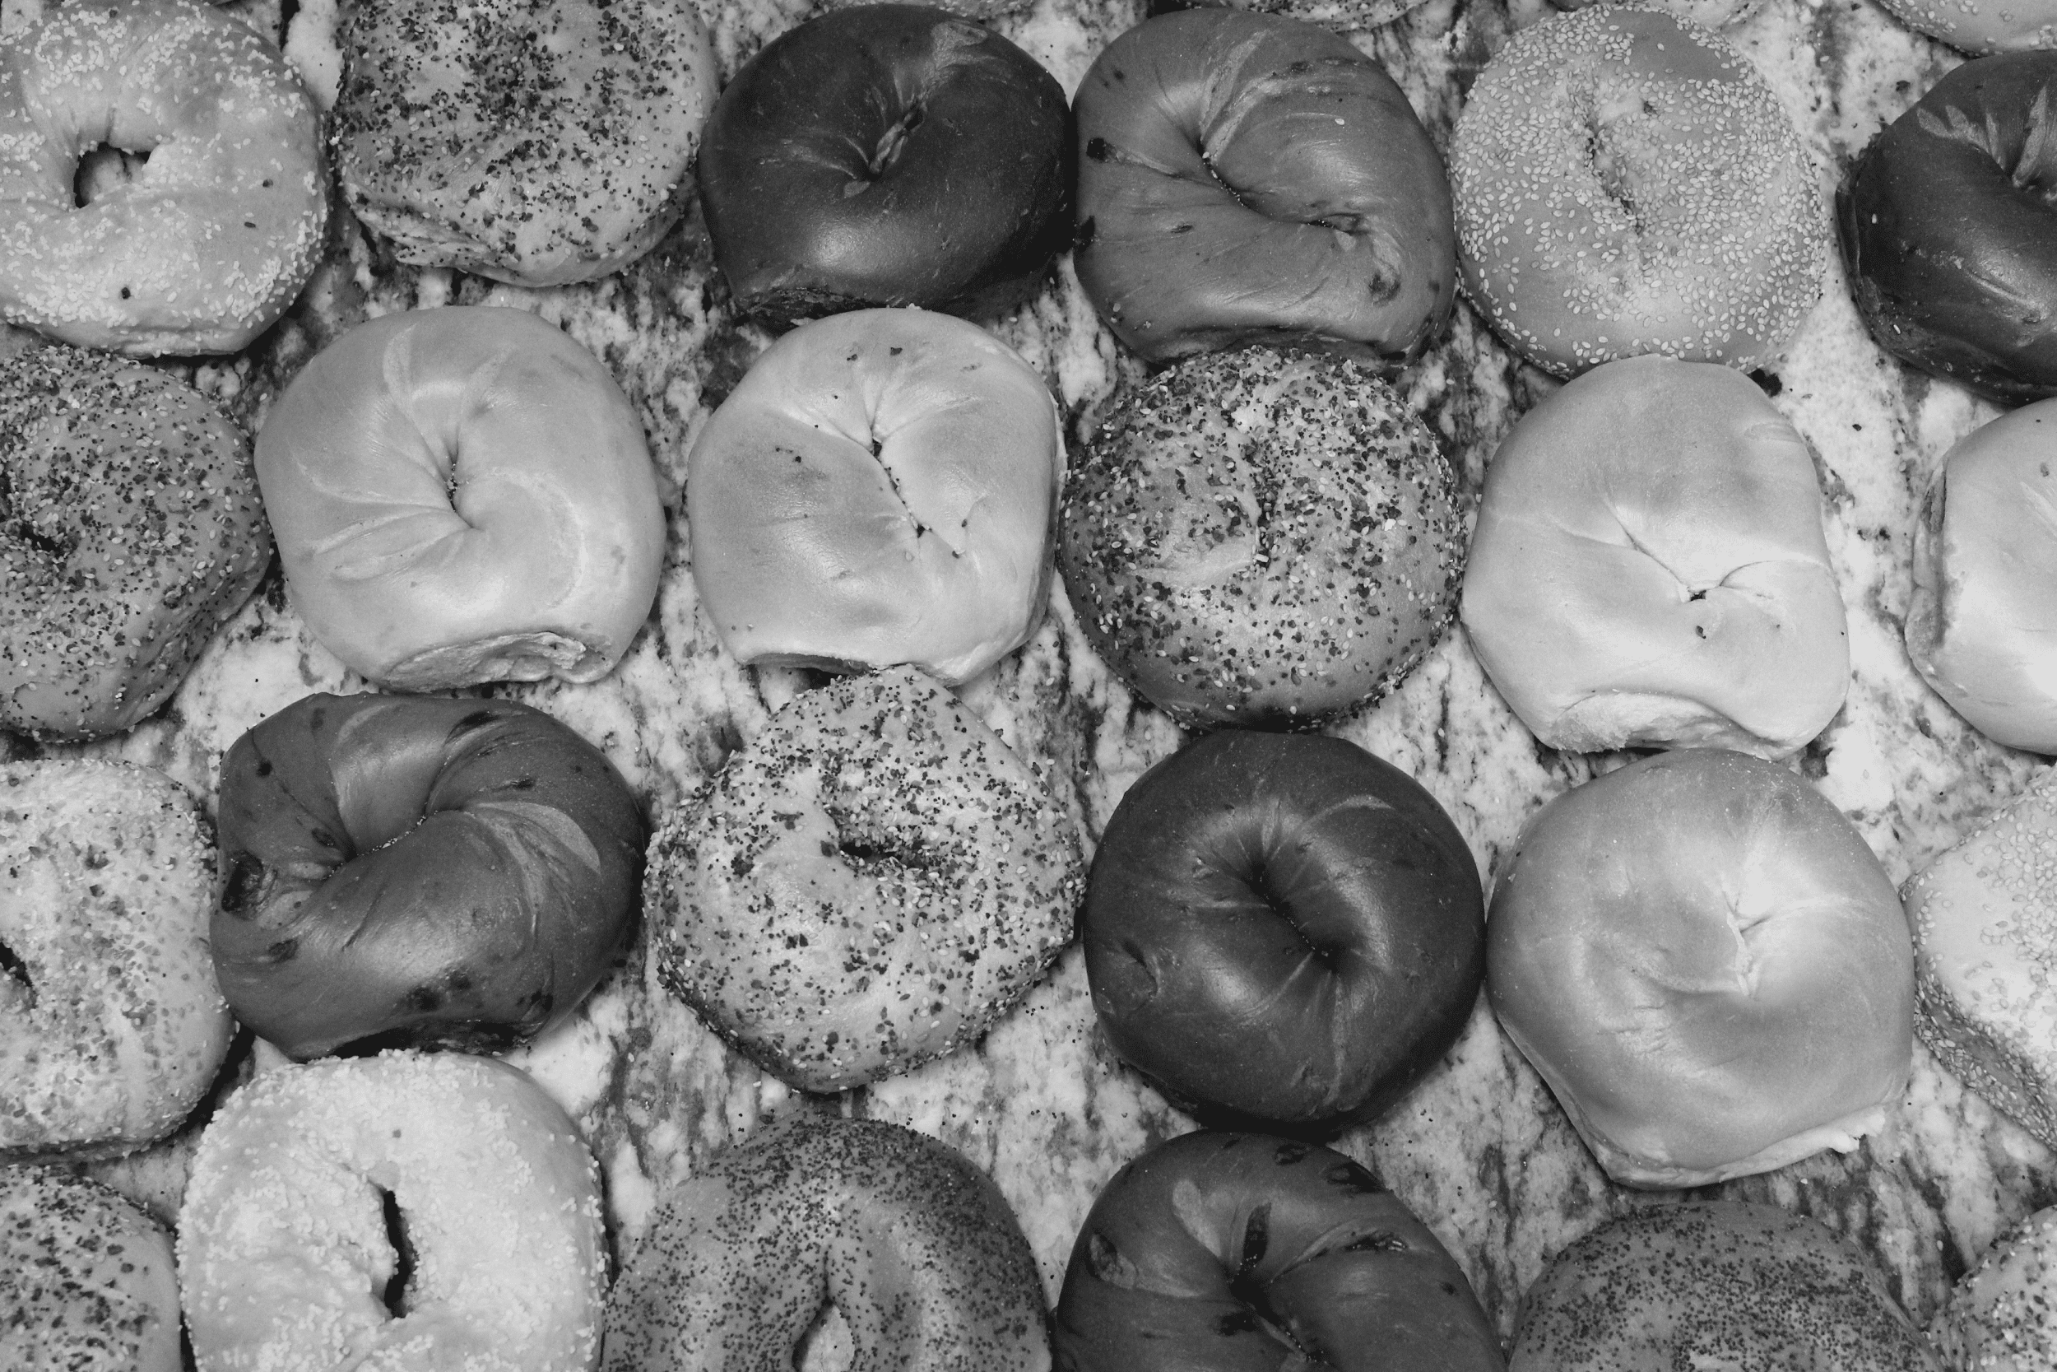
GitHub URL: https://github.com/Team2-Inwood-Bagels

Slide 3
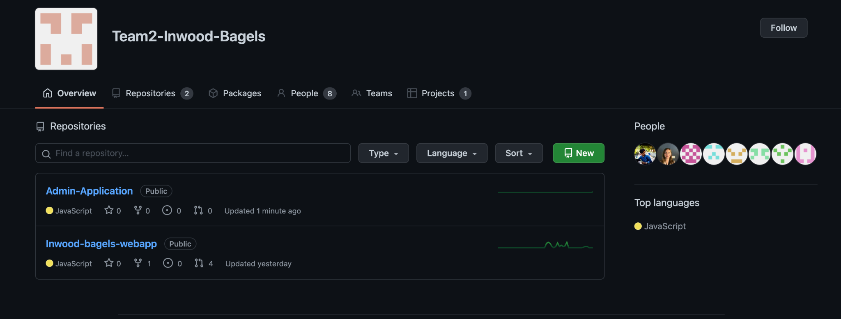
Organization Overview

Slide 4
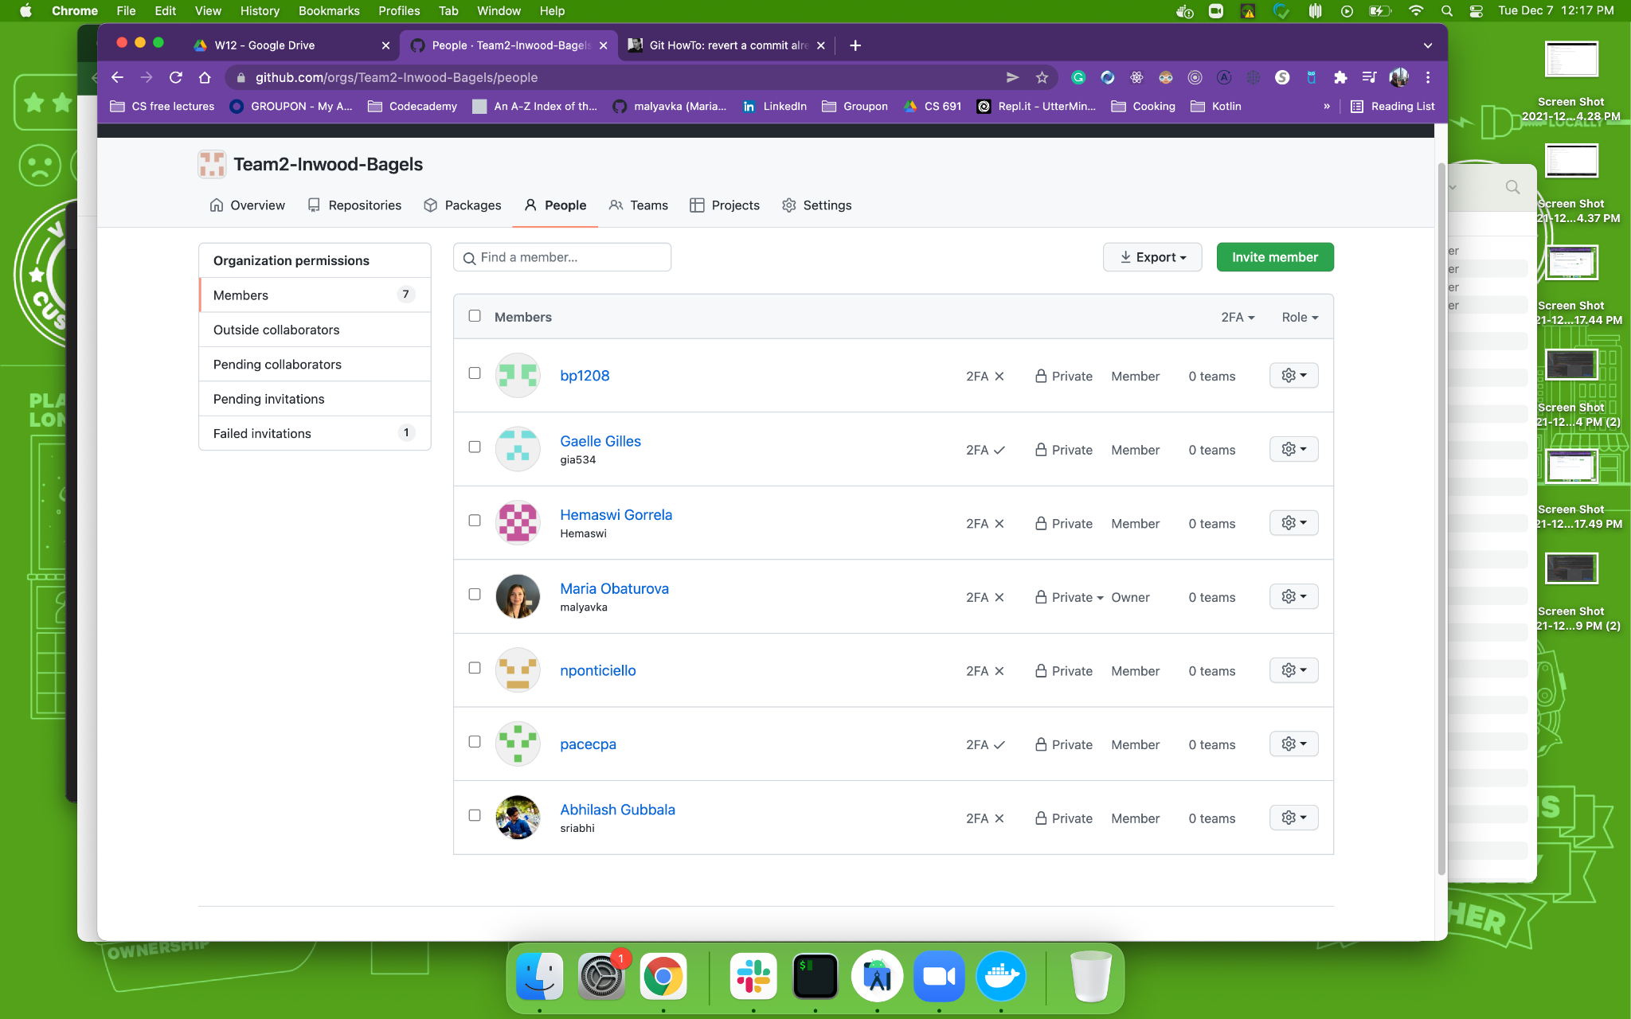
Organization Overview

Slide 5
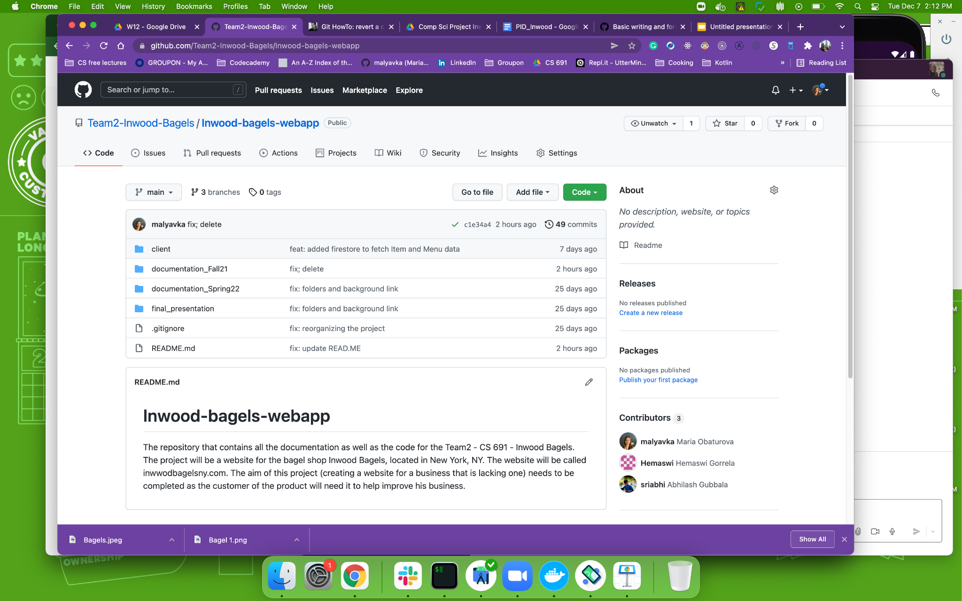
Repository Structure

Slide 6
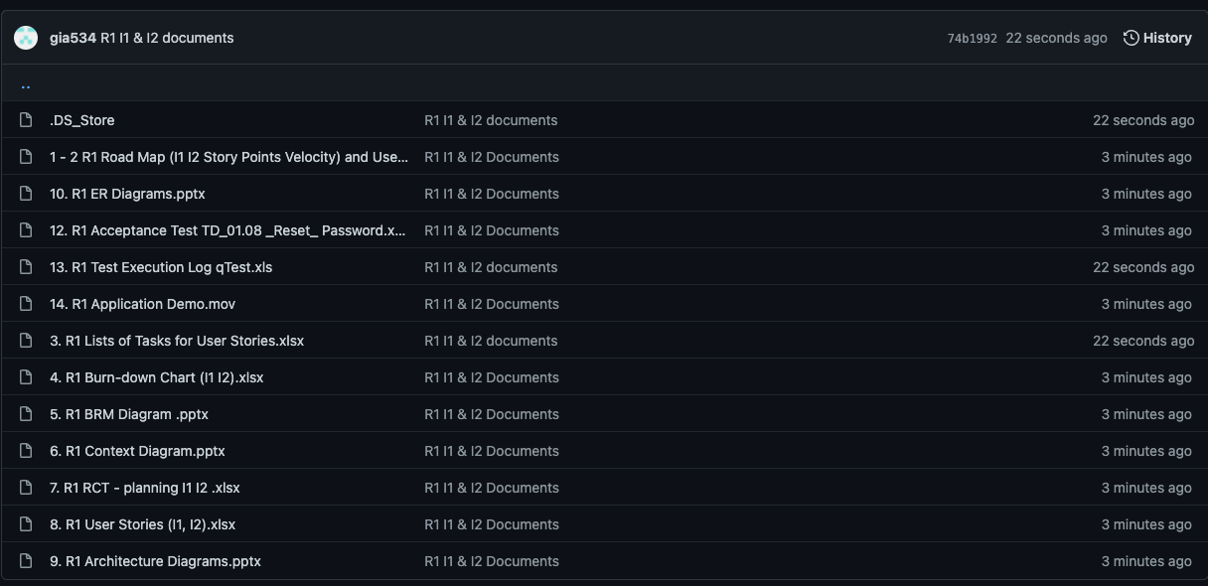
Documentation Folder

Slide 7
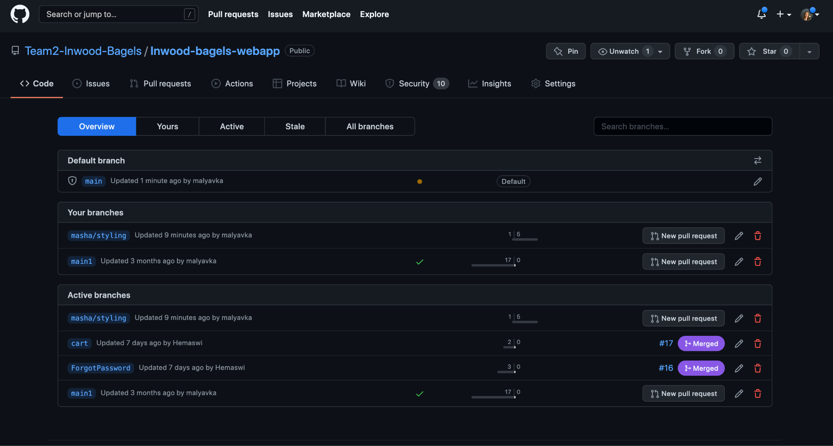
Testing on branches before merging PRs

Slide 8
Build & Run Precedures
Node.js should be installed on the machine
Clone from the GitHUB remote repository
Open the Project in the Text Editor of your choice
Be sure to be in a /Client folder
cd Client
Run npm install in the Terminal window
Run npm start in the Terminal window
Open the browser window and http://localhost:3000/
Important: the configuration file with the API keys and other credentials are not stored in a public GitHUB repo. In order to maintain it, please, reach out to the Lead Developer

Slide 9
Working on User Stories Procedure And Testing
Create a branch from main branch starting with the name of the developer followed by slash with the description of the task
git checkout -b’masha/cart’
Work, commit, OPen a Pull Request
Reach out to QA to ask to do a smoke test
Ask another developer to Review a PR
Address comments in a review
Adreess comments of QA
When everything is ok, merge it to main
Before starting to work, always run
git fetch
git pull

Slide 10
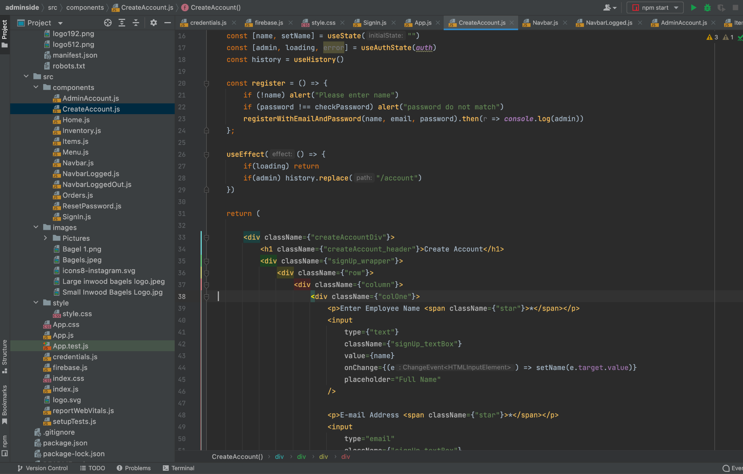
Code Examples - Create Admin Account

Slide 11
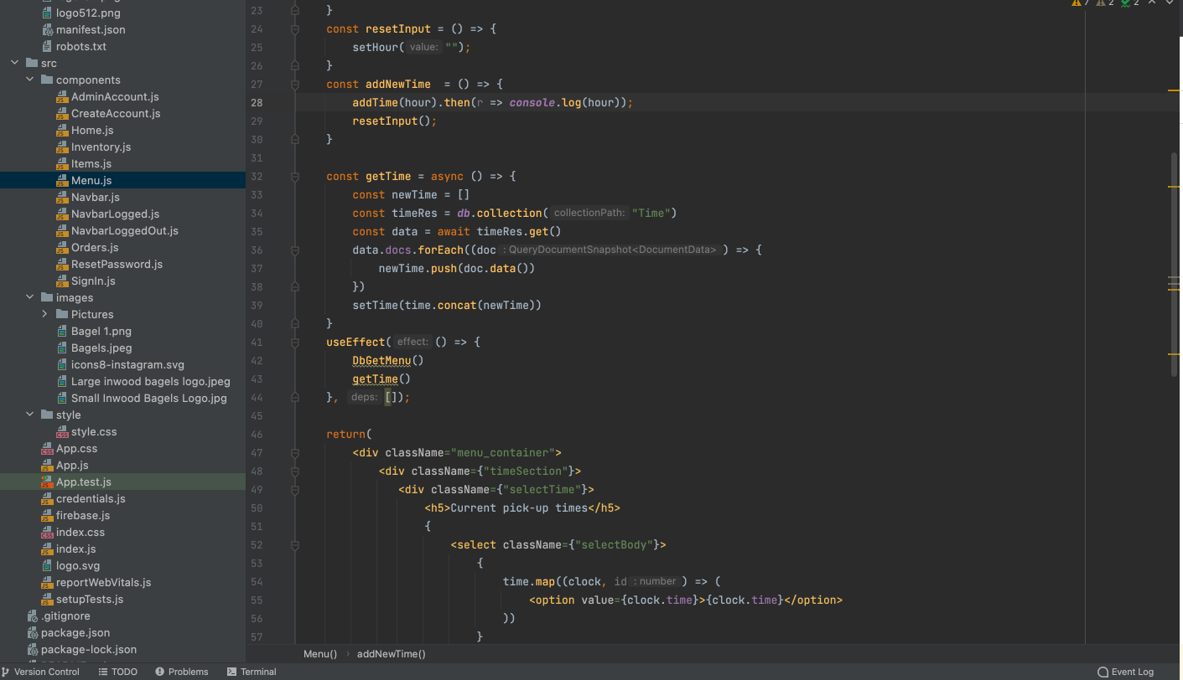
Code Examples - Set Pick Up Times

Slide 12
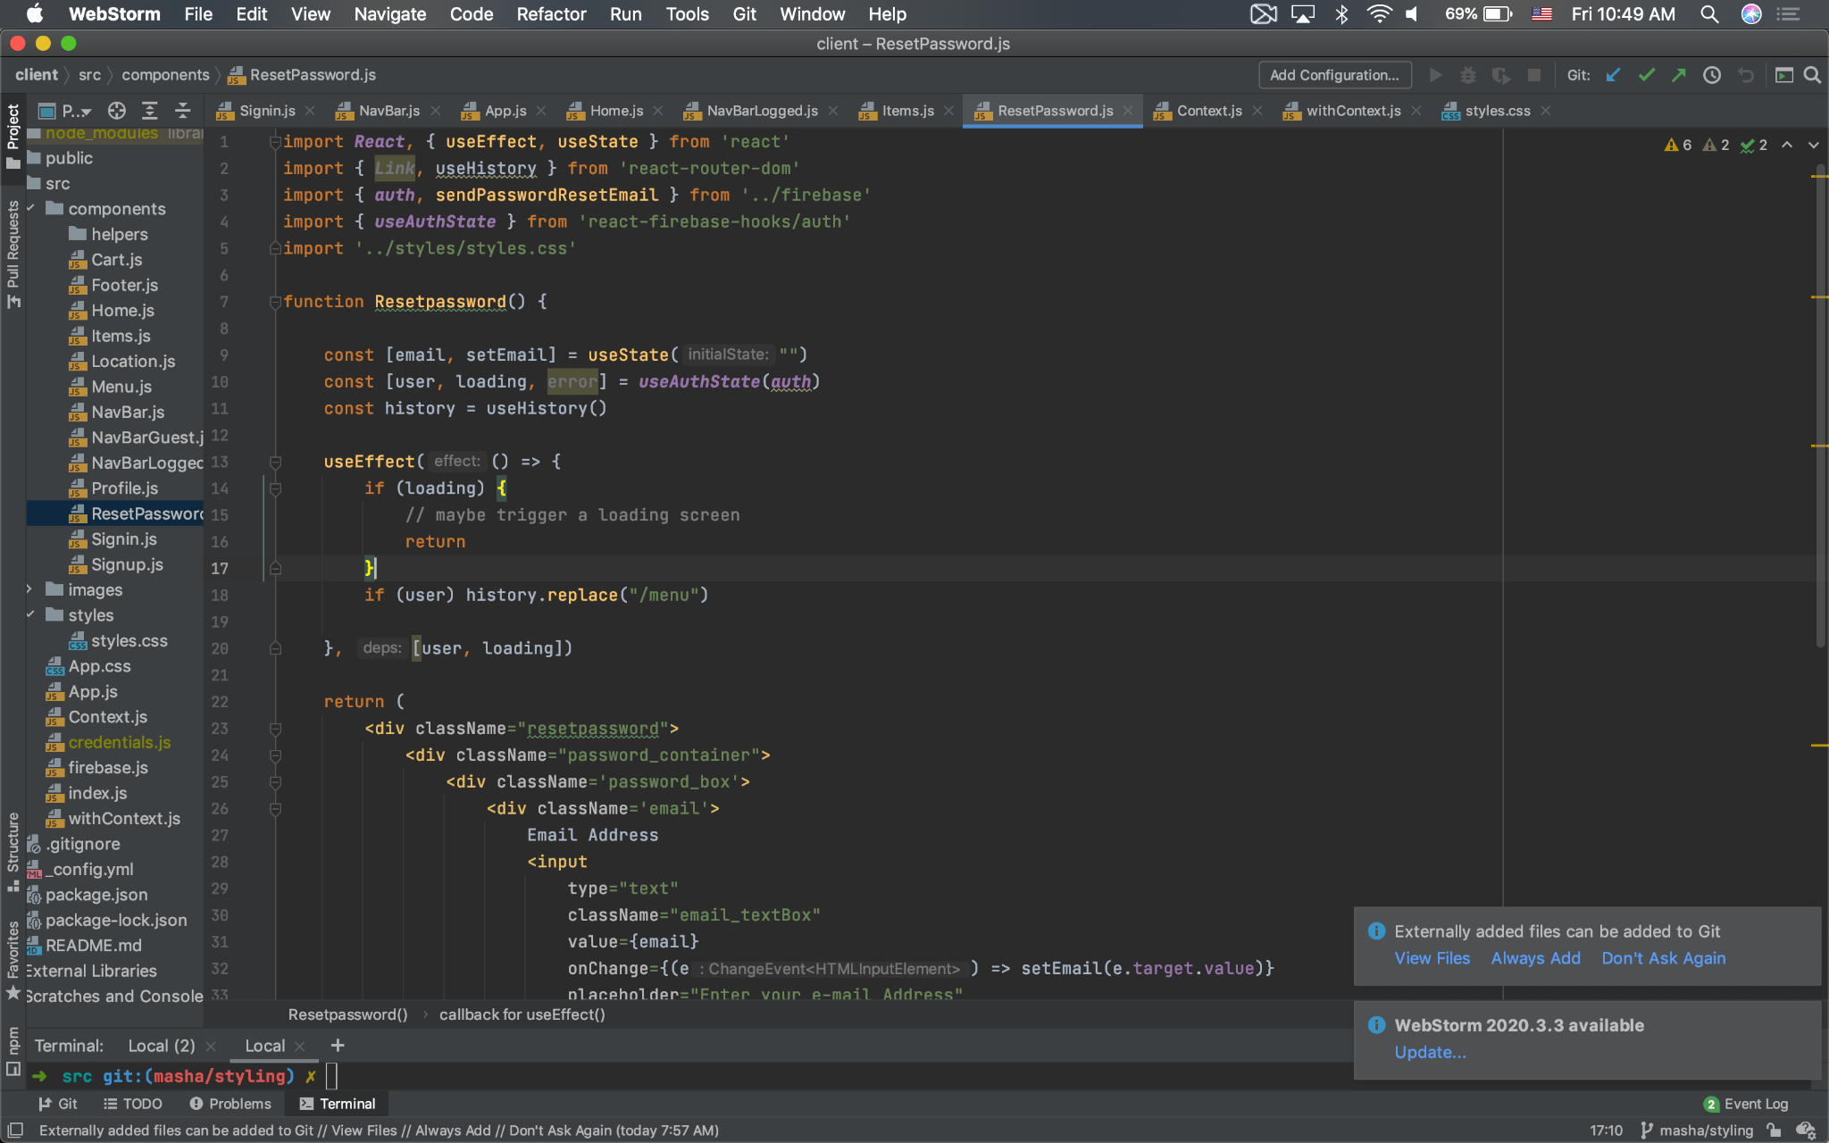
Code Examples - Reset Password

Slide 13
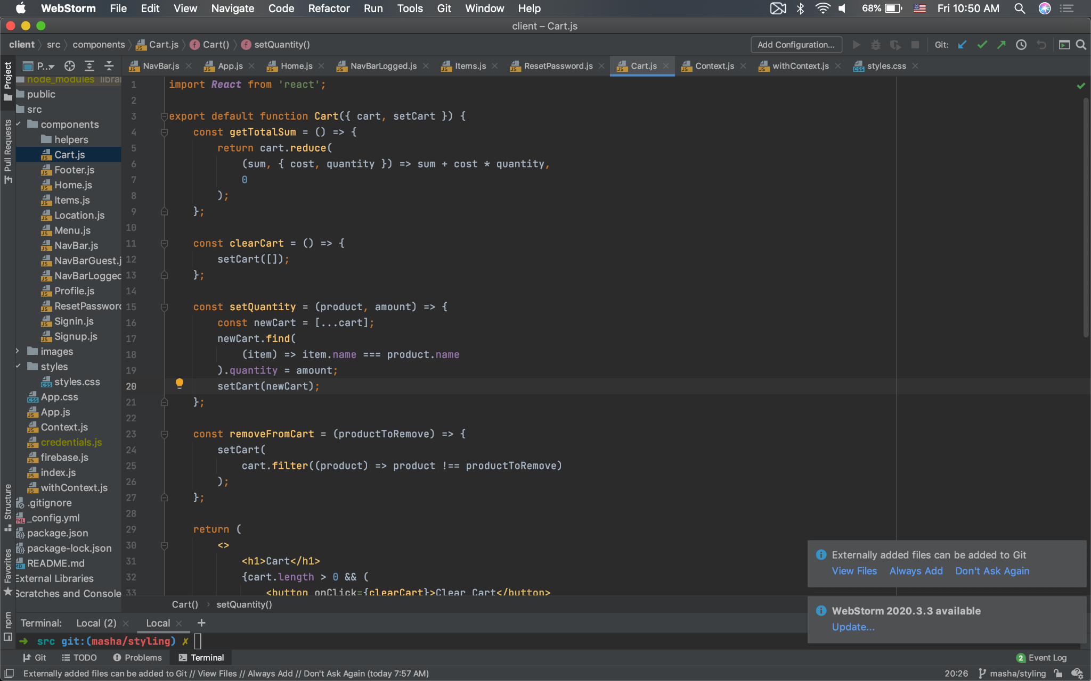
Code Examples - Cart

